Slide 1


Slide 2
EagleSat’s
Electronic Power Subsystem
Jon Lowe

Slide 3
Electronic Power Subsystem (EPS) Outline
Requirements
EPS Description
Power Flow
Solar Cells/Panels
EPS components
Energy Budget

Slide 4
EPS Requirements
Launch Power Activity | No electronics active during launch
Deployment Switch | Deployment switch on standoff rail disconnects all power while depressed
Access Port Locations | All connectors located in designated areas
Remove Before Flight Pin | Will have a remove before flight pin
EPS | EPS will manage all power distribution
Solar Panels | Solar panels will provide sufficient power to fulfill EagleSat’s power need

Slide 5
EPS Description
    Collects power for EagleSat using solar panels
    Super capacitors store energy
    Vcc Batt powers Radio, Regulator
    Regulator powers Vcc Sys
    Vcc Sys powers OBC, Temperature sensors, Modem, GPS
    OBC determines standby/off

Slide 6
Power Flow
Solar Panels
Voltage Regulator
OBC
Modem
GPS
Temperature Sensors
Super Capacitors
VCC BATT
VCC SYS
Radio

Slide 7
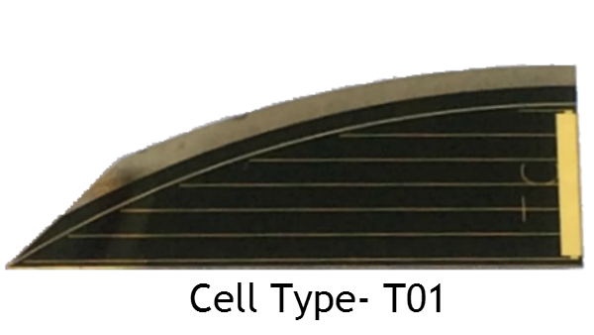
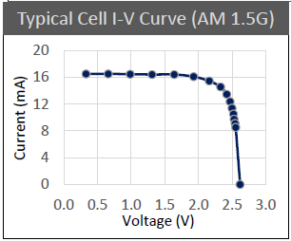
Solar Cells
TriSolX Solar Wings
  28% Efficient InGaP/GaAs/Ge Triple Junction Solar Cells: Type- T01
  Voltage (Open circuit) 2.62 V
  Voltage (Max Power) 2.33 V
  Current (Max Power) 14.6 mA
  Power (Max Power) 34 mW
  Dimensions: 26.3mm x 10mm

Slide 8
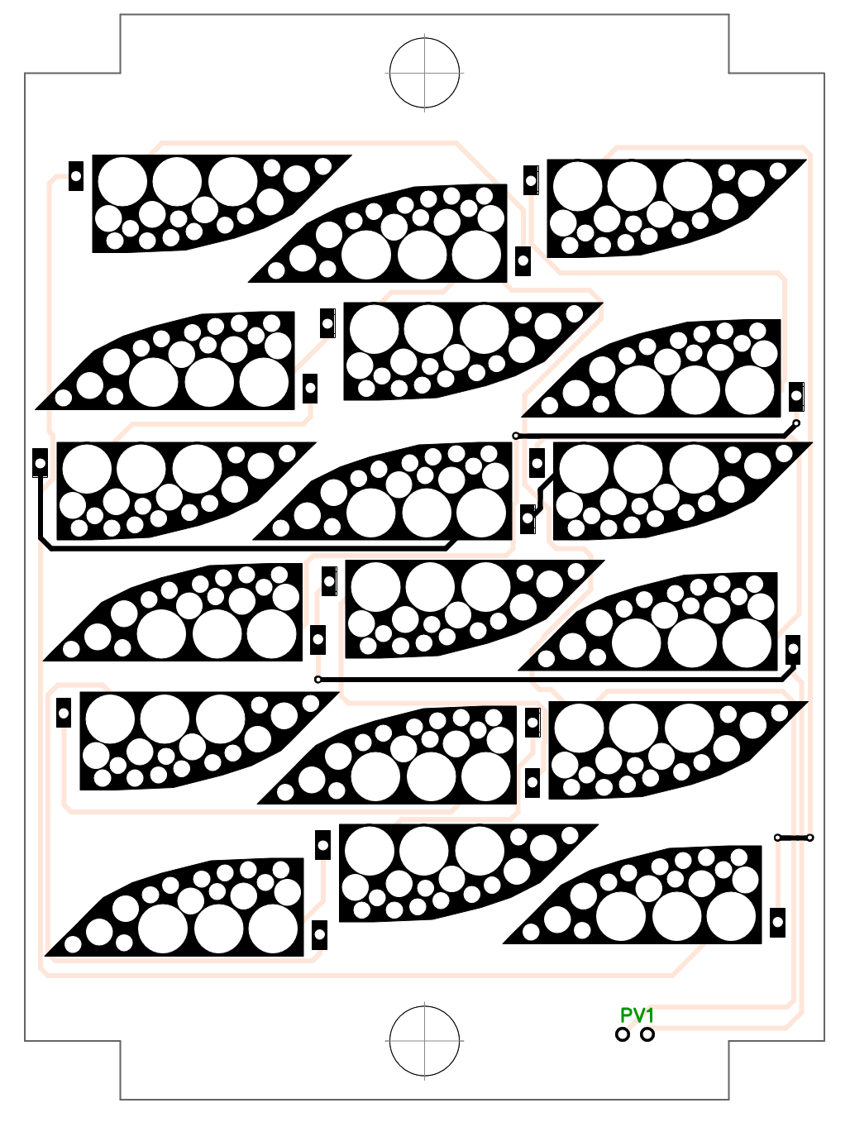
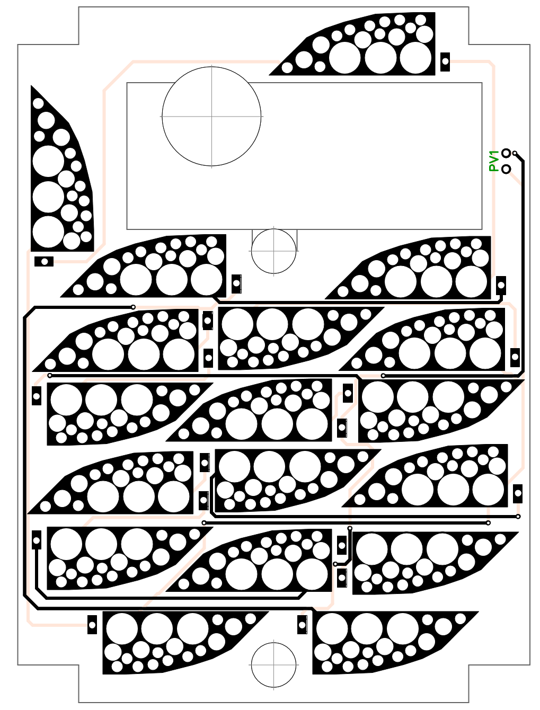
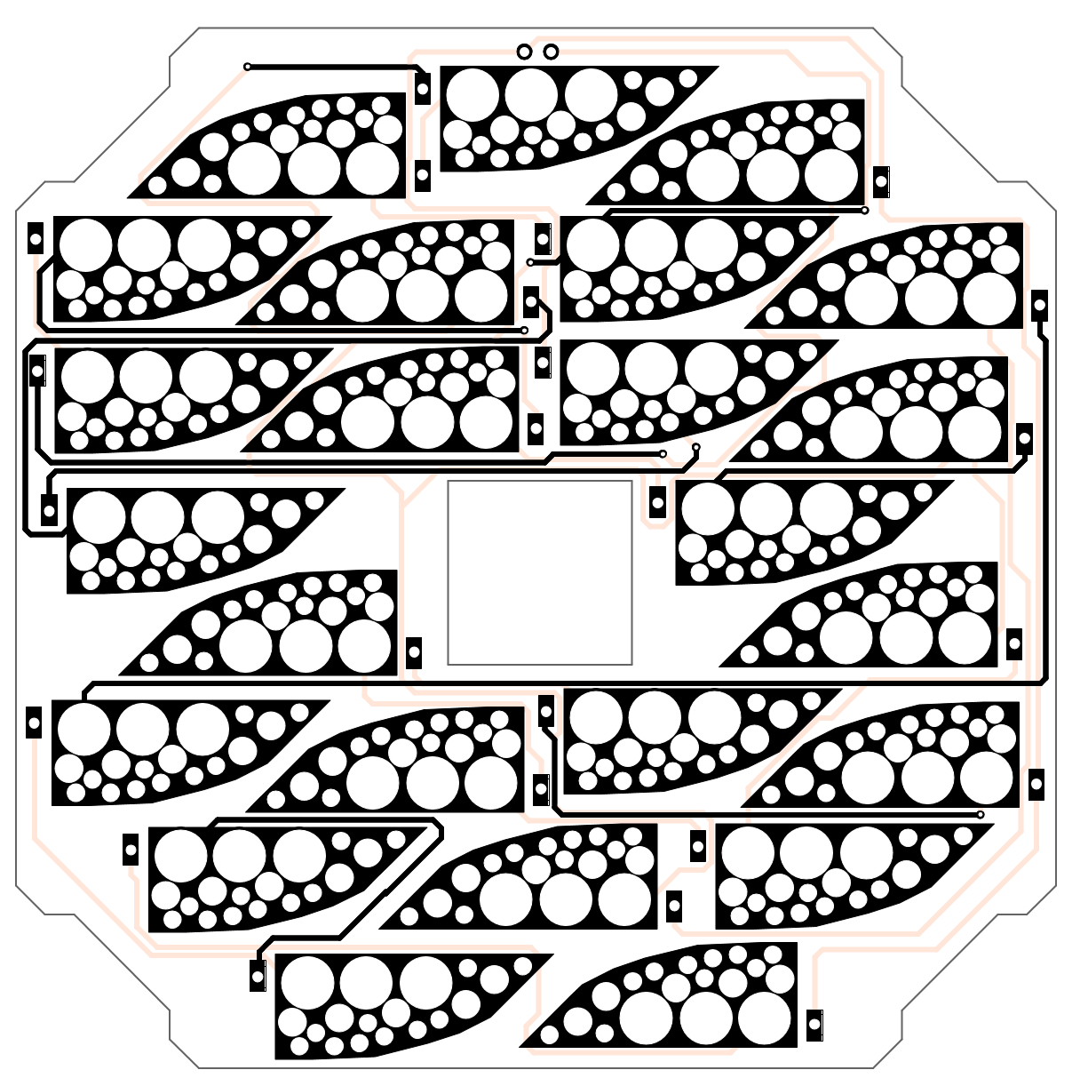

Solar Panels
Side Panels ($±Y)$ Top Panel (-Z) Front Panel (+X)

Slide 9
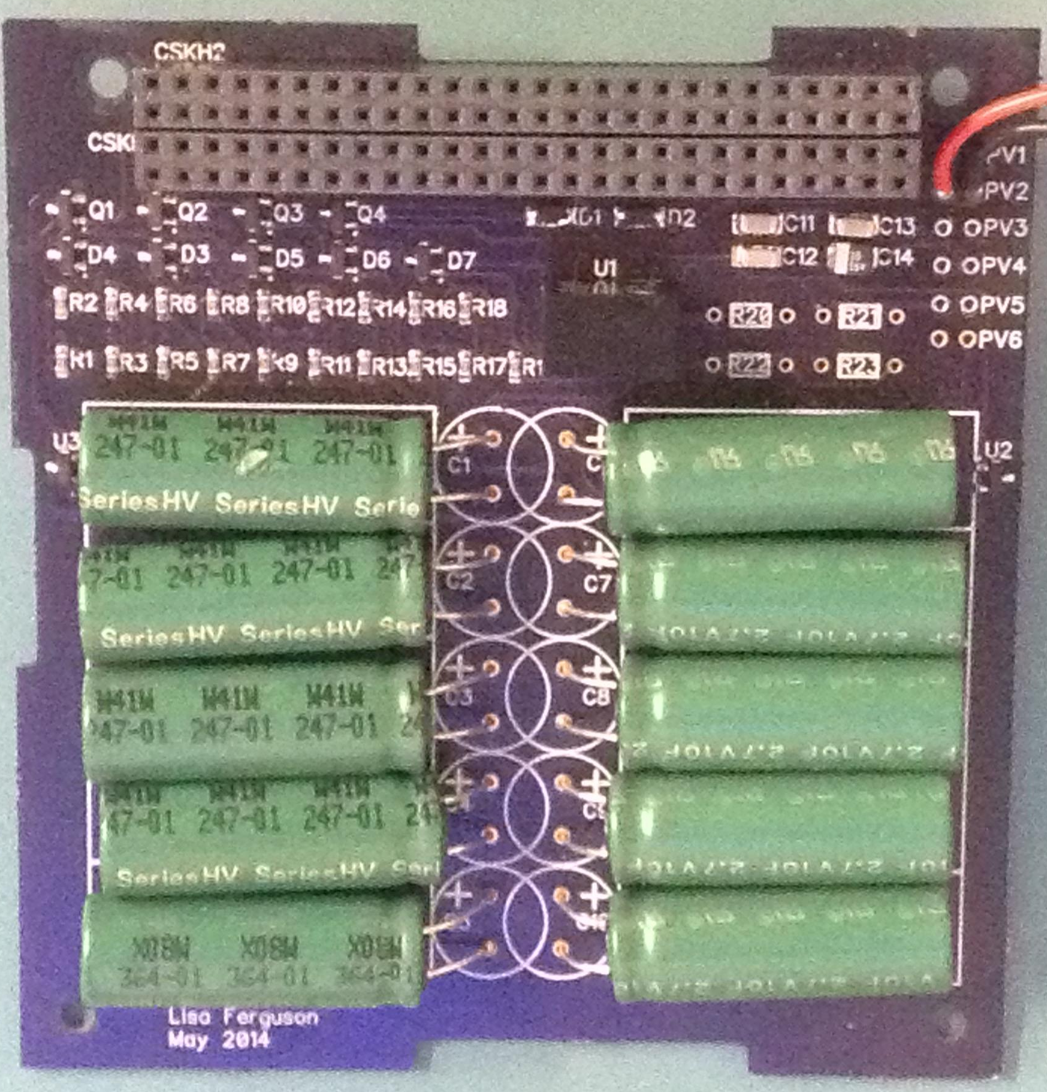
Supercapacitors
Eaton HV1030-2R7106-R 10F (3V)
Supercapacitors
UL Listing: BBBG2.MH46887
5 per series bank (15V)
2 banks in parallel providing 4F
1125J total charge at max power

Slide 10
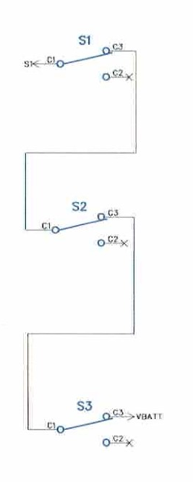
Deployment Switches
3 Total switches
2 on standoff rails
1 remove before flight pin
Power disconnected when switches depressed and
remove before flight pin present

Slide 11

Voltage Regulator
RECOM R-78E3.3-0.5
Input Range: 4V-28V
Output Voltage: 3.3V
Output Current: 500mA

Slide 12


Temperature Sensor
Microchip TC1047A
Input Voltage 2.5V to 5.5V, 7V absolute max
Temperature Range: -40$℃$ to 125$℃$
Output Voltage: 0.1V to 1.75V

Slide 13

Temperature Sensor
Vout = (10mV/$℃$)(Temperature $℃$) + 500mV

Slide 14
Cumulative Energy Budget

Slide 15
Cumulative Energy Budget

Slide 16
EPS Summary
All requirements are met
No electronics shall be active at launch
Deployment switches prevent EagleSat from being powered when switches are depressed
Access ports are present and allow access to connectors while in P-POD
RBF pin prevents EagleSat from being powered until removed
EPS manages EagleSat’s power distribution
Solar Panels provide sufficient power for EagleSat to function properly

Slide 17
Questions?

Slide 18
Backup Slides

Slide 19
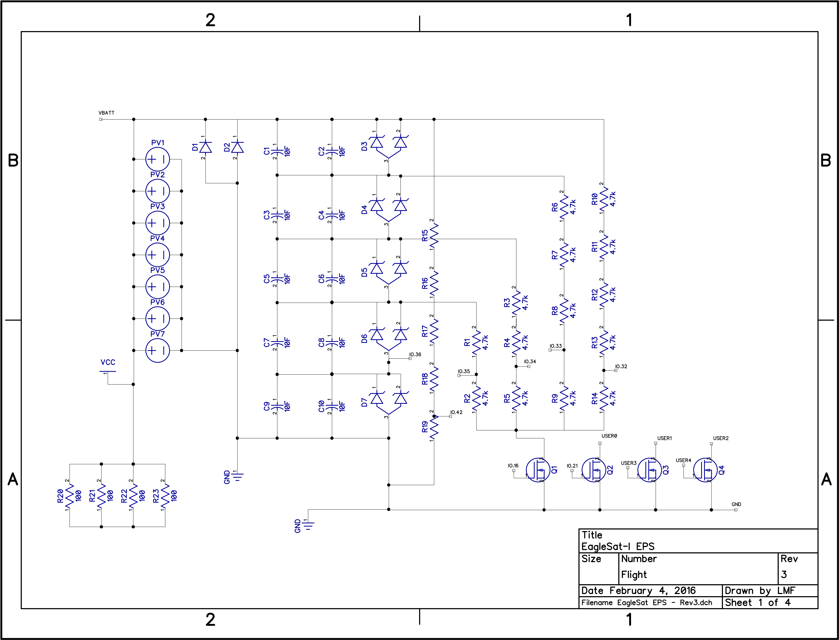
EPS Board Schematic

Slide 20
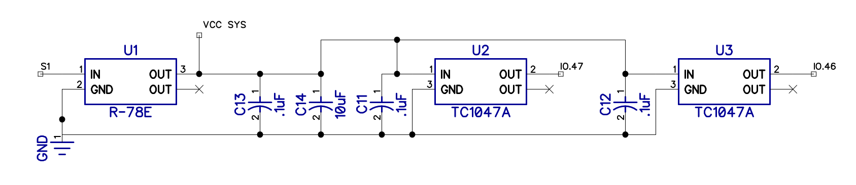
Temperature Sensor Schematic

Slide 21
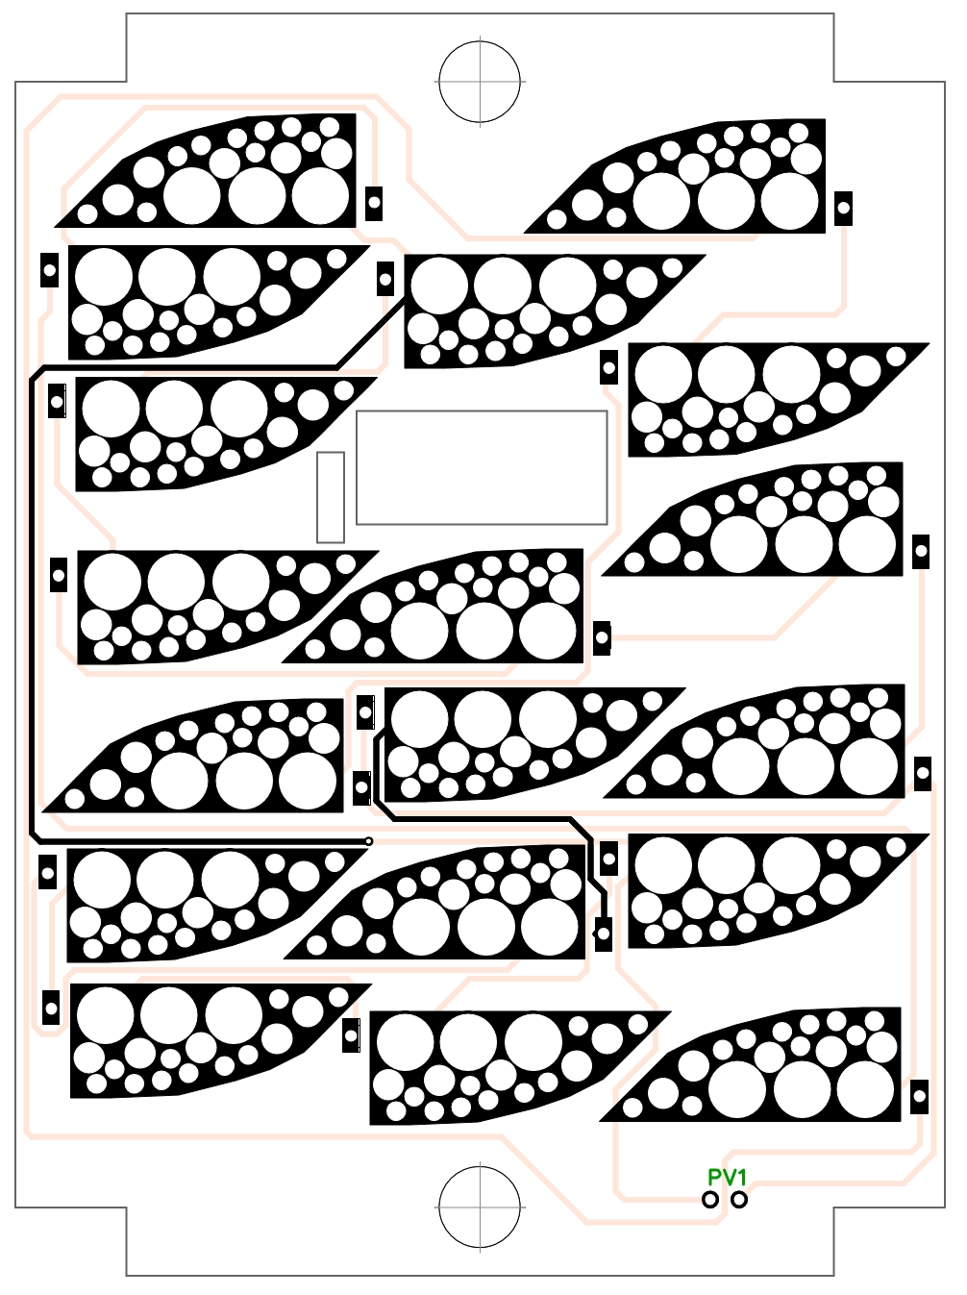
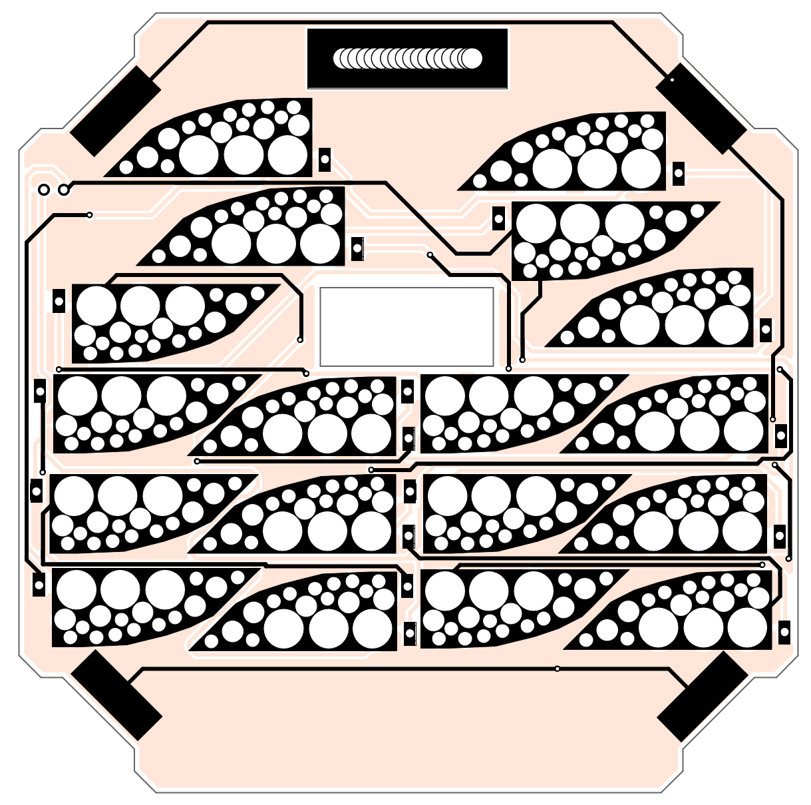
Remaining Solar Panels
Back
Panel
(-X)
Bottom
Panel
(+Z)

Slide 22
Perfect Energy Budget

Slide 23
Worst Case Scenario Energy Budget

